Slide 1

DMart Pricing & Assortment
Strategy Analysis
A Full Exploratory, SQL & NoSQL Analysis of DMart's Real Product Catalog
Data Analytics Portfolio Project | 5,181 SKUs | 21 Categories | 822 Brands

Slide 2




Business Problem
DMart's catalog spans 5,000+ SKUs across 21 categories and 822 brands. Leadership needs visibility into:
Discount Consistency
Brand Concentration
Assortment Depth
Pricing Outliers
Is discounting strategy deliberate and category-tiered, or inconsistent?
How exposed are categories to private-label vs. branded competition?
Is SKU depth balanced relative to each category's importance?
Where do extreme-priced products distort category benchmarks?
DMart Pricing & Assortment Strategy | 2

Slide 3
Data & Methodology
Real DMart product catalog (not transactional sales data) — analysis scoped to pricing, discounting & assortment strategy.
1
Removed duplicates & rows with missing core fields
5,181
21
2
Fixed 13 mis-categorized rows (brand scraped as category)
Clean SKUs
Categories
3
Standardized 21 Sub-Category labels via BreadCrumbs hierarchy
4
Parsed free-text Quantity ("500 gm", "2x1L") into numeric + unit
822
0
5
Derived Discount Amount & Discount % per product
Brands
Critical Nulls
6
Built Price Band tiers: Budget / Mid / Upper-Mid / Premium
DMart Pricing & Assortment Strategy | 3

Slide 4
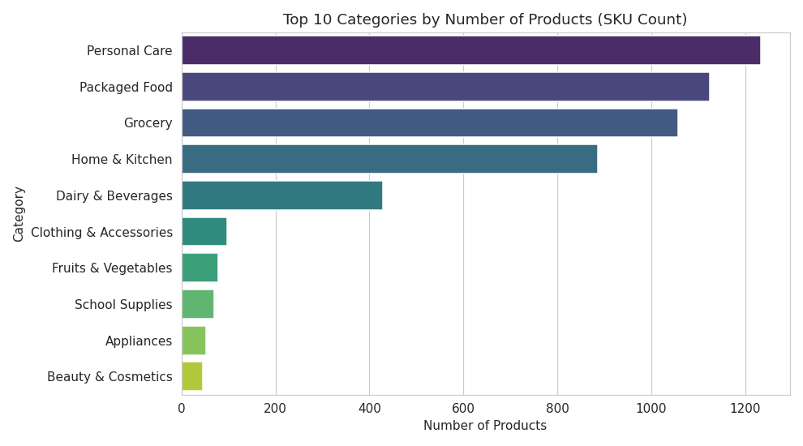
Catalog Composition
Personal Care, Packaged Food, Grocery & Home/Kitchen dominate the assortment by SKU count.
DMart Pricing & Assortment Strategy | 4

Slide 5
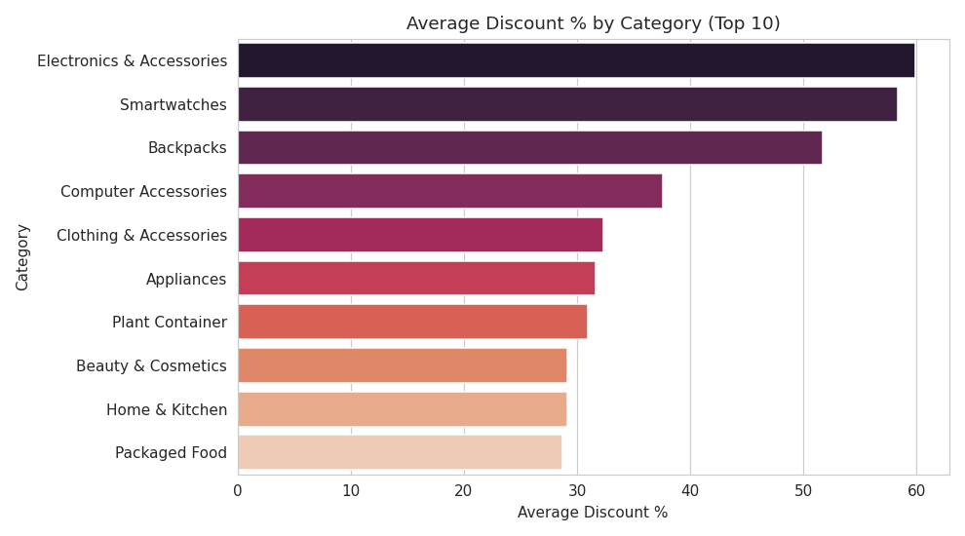
Discounting is Sharply Category-Tiered
Discretionary categories (Electronics, Backpacks) discounted 2x harder than daily staples.
DMart Pricing & Assortment Strategy | 5

Slide 6
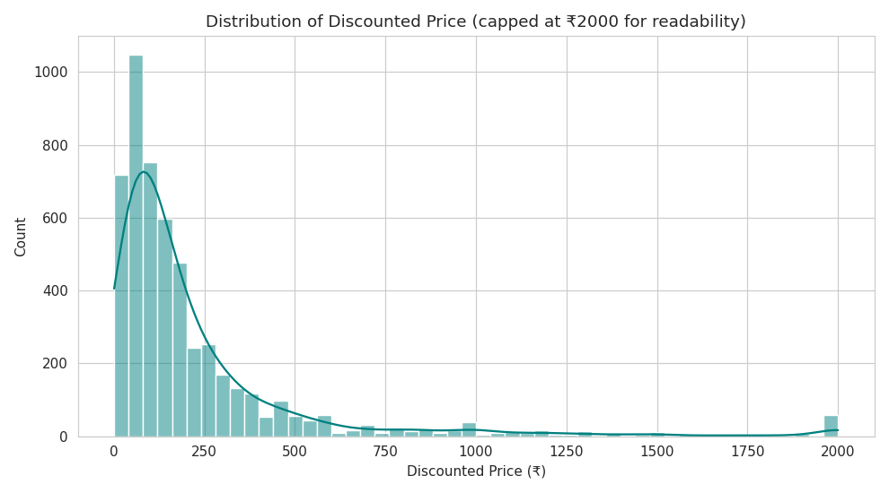
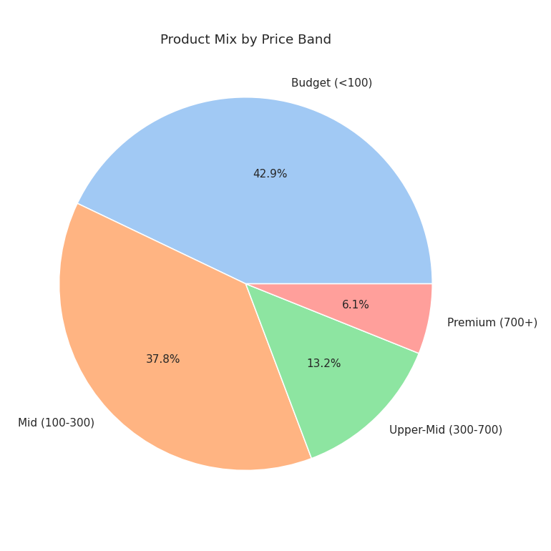
Value-Led Price Positioning
Median price: ₹175 | Average price: ₹344 (pulled up by premium outliers)
DMart Pricing & Assortment Strategy | 6

Slide 7
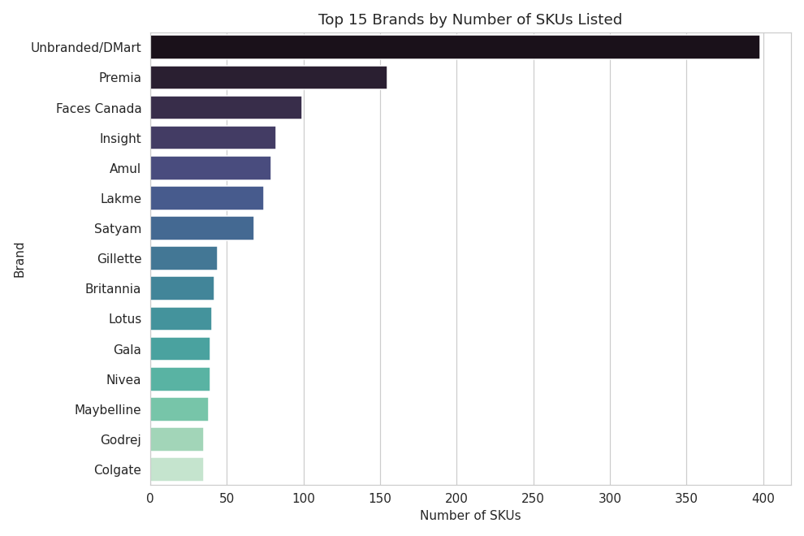
Private Label Leads the Brand Landscape
“Unbranded/DMart” is the single largest “brand” by SKU count, ahead of every national brand.
DMart Pricing & Assortment Strategy | 7

Slide 8
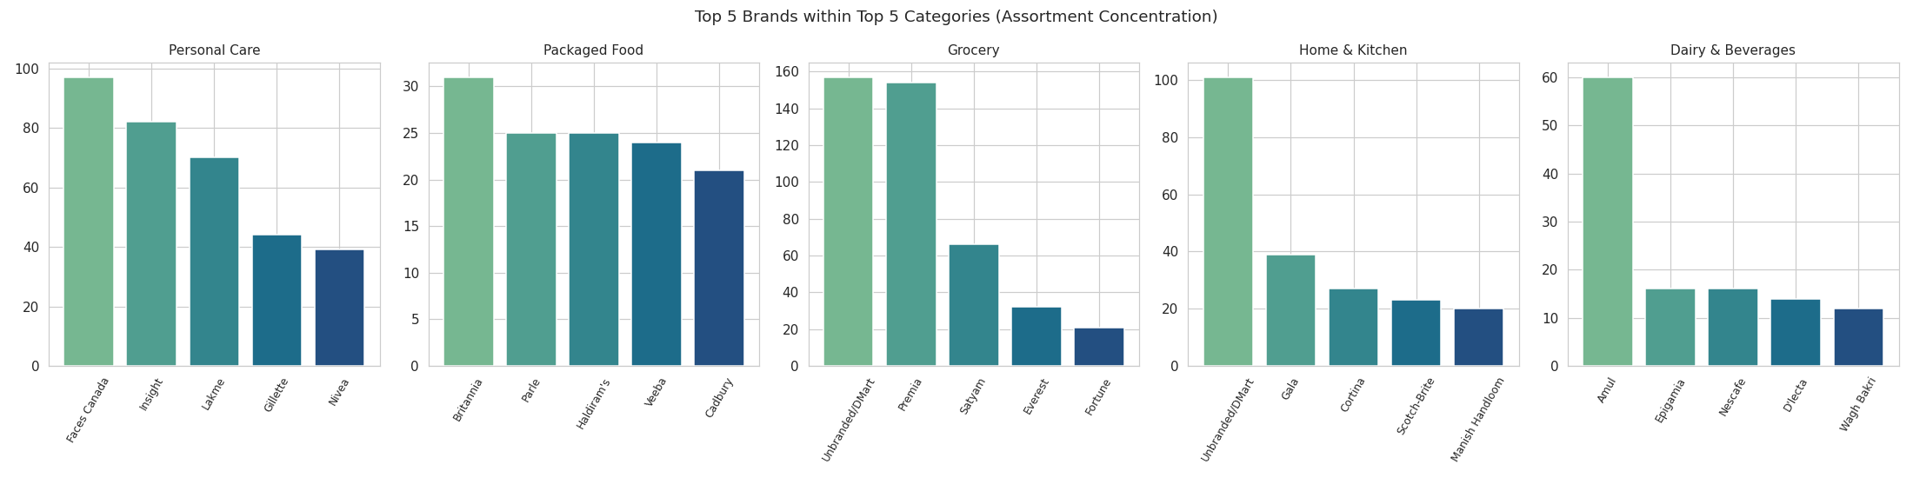
Brand Concentration Varies by Category
Private label fully owns Fruits & Veg, Plant Containers, Tableware. Branded players lead Personal Care & Dairy.
100% private-label share in: Fruits & Vegetables • Plant Containers • Tableware — zero branded competition in these categories
DMart Pricing & Assortment Strategy | 8

Slide 9

SQL Analysis (SQLite)
Business questions answered with GROUP BY, window functions & joins on the cleaned catalog.
Q | Question | Top Result
1 | Deepest avg. discount by category | Electronics & Accessories — 59.9%
2 | Highest avg. price brand (5+ SKUs) | Boat — ₹3,275.71
3 | Category fully owned by one brand | Fruits & Veg, Tableware — 100% DMart
4 | Most extreme priced outlier | Philips UV-C System — ₹10,990 (22x category avg.)
5 | Steepest individual product discount | Naagin Hot Sauce — 98% off
DMart Pricing & Assortment Strategy | 9

Slide 10

MongoDB Aggregation Pipeline (Bonus)
Same business questions re-run as NoSQL aggregation pipelines — results cross-validated against SQL.
db.products.aggregate([
{ $group: { _id: "$Category",
avg_discount_pct: { $avg: "$Discount_Pct" },
sku_count: { $sum: 1 } } },
{ $sort: { avg_discount_pct: -1 } },
{ $limit: 10 }
])
Result matched SQL exactly:
Electronics & Accessories: 59.87%
Smartwatches: 58.34%
Backpacks: 51.73%
Note: executed via mongomock (in-memory MongoDB-compatible engine, no live DB network access in this environment) — identical syntax to production MongoDB/Atlas.
DMart Pricing & Assortment Strategy | 10

Slide 11

Key Findings & Recommendations
Findings
Recommendations
Discounting is deliberately tiered: staples ~28%, discretionary 50–60%
Private label is the largest “brand” and fully owns 3 categories
A few outlier-priced products distort category price benchmarks
Catalog is heavily Budget/Mid weighted — value positioning
Some discounts (e.g. 98%) warrant a data-accuracy check
Audit 100% private-label categories — confirm intentional, not a gap
Validate extreme-discount SKUs (>75%) for data accuracy
Separate premium outliers into their own pricing segment
Formalize discount-tiering policy by category type
DMart Pricing & Assortment Strategy | 11

Slide 12

Next Step: Live Monitoring Dashboard
Recommended scope for a Power BI / Tableau dashboard extending this analysis
1
Category KPI cards: SKU count, avg. price, avg. discount %
Future extension:
2
Discount outlier alerting (flag SKUs outside category norms)
With true transactional data (orders, quantities, dates), this evolves into full sales performance, demand forecasting & customer analytics.
3
Private-label share tracker (alert if >80% category share)
4
Price-band mix trend over time, by category
5
New / discontinued SKU tracker across catalog snapshots
Thank you | DMart Pricing & Assortment Strategy Project

